Slide 1
Yes Bank Stock Closing Price Prediction using Machine Learning
Presented by:
Komala p
B.Tech – Computer Science & Engineering
LabMentrix AI/ML & Data Science Internship

Slide 2
Problem Statement
Stock price prediction is an important application of Machine Learning.
The objective of this project is to predict the closing stock price of Yes Bank.
Historical stock prices are used to train machine learning models.
To develop a machine learning regression model that predicts the closing stock price of Yes Bank using historical stock price data.

Slide 3
Business Objective
📈 Analyze historical stock prices
🔍 Identify relationships
🤖 Build regression models
📊 Compare model performance

Slide 4
Dataset Information
Dataset: Yes Bank Historical Stock Prices
Total Records: 185
Total Features: 5
Feature | Description
Date | Trading Date
Open | Opening Price
High | Highest Price
Low | Lowest Price
Close | Closing Price (Target)

Slide 5
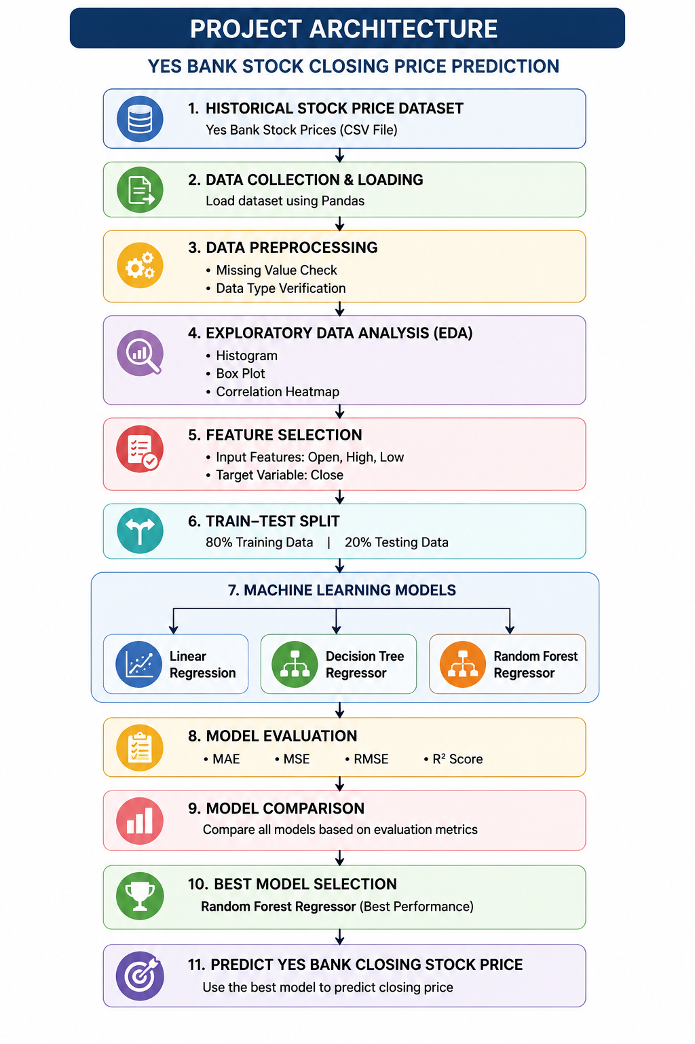
Project Architecture
Figure 1: Machine Learning Project Architecture

Slide 6
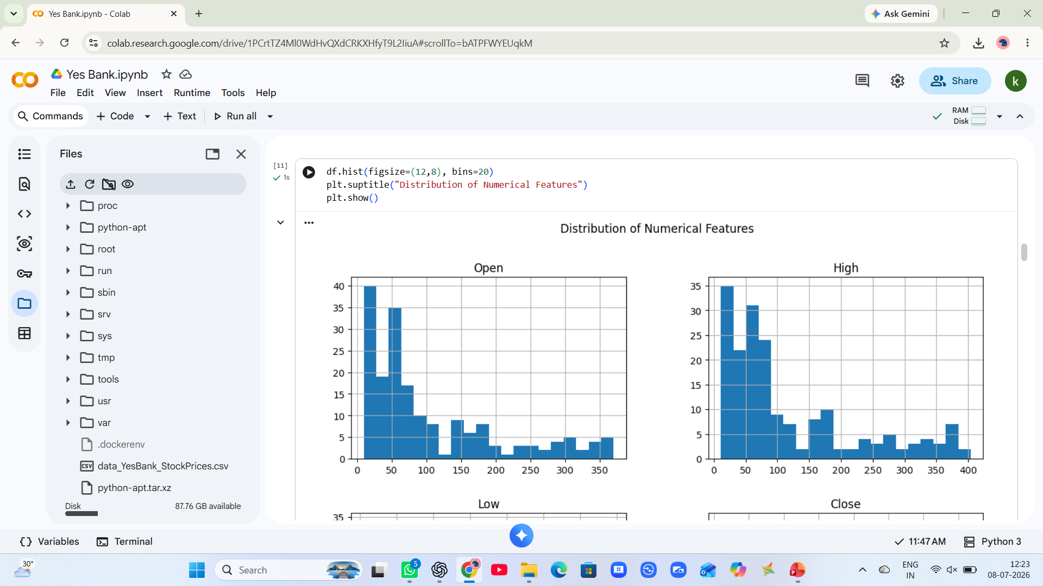
Exploratory Data Analysis (EDA)
Exploratory Data Analysis
Performed the following analyses:
Checked dataset shape and data types
Checked missing values
Generated statistical summary
Histogram
Box Plot
Correlation Heatmap
Key Observation
No missing values
Strong positive correlation among Open, High, Low, and Close prices

Slide 7
Machine Learning Workflow
Historical Stock Price Data
↓
Data Preprocessing
↓
Exploratory Data Analysis
↓
Feature Selection
↓
Train-Test Split (80:20)
↓
Machine Learning Models
↓
Model Evaluation
↓
Best Model Selection
↓
Predict Closing Stock Price

Slide 8
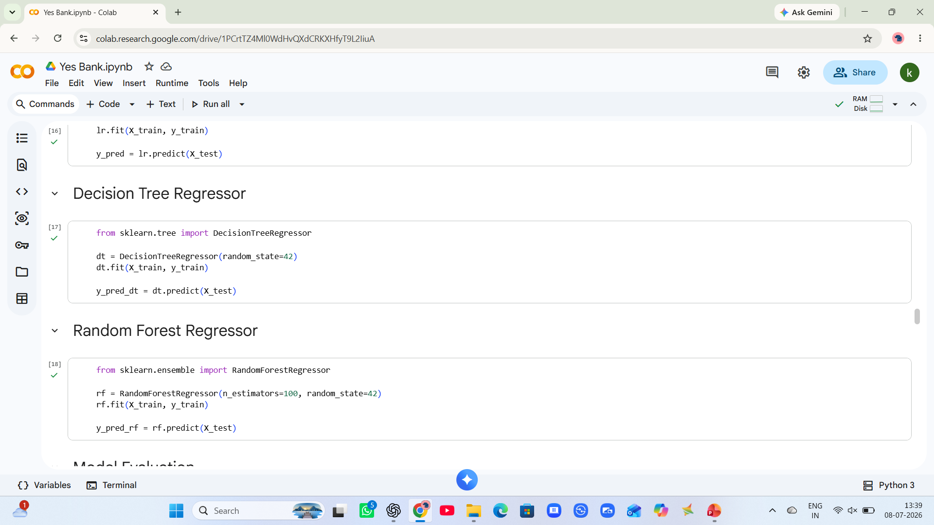
Models Used
Linear Regression
✔ Simple model
✔ Linear relationship
Decision Tree
✔ Decision rules
✔ Non-linear data
Random Forest
✔ Multiple trees
✔ High accuracy
✔ Best model

Slide 9
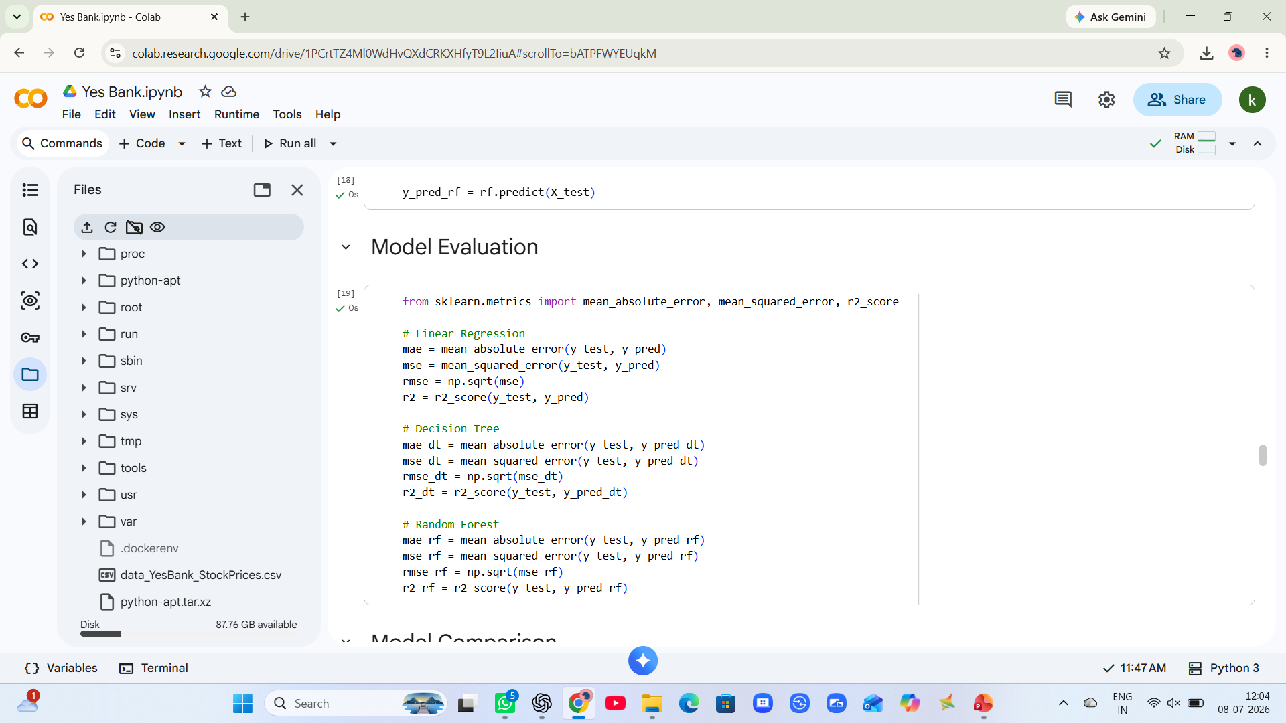
Model Evaluation
Evaluation Metrics
Used the following metrics:
Mean Absolute Error (MAE)
Mean Squared Error (MSE)
Root Mean Squared Error (RMSE)
R² Score
Best Model
Random Forest Regressor
Reason:
Lowest MAE
Lowest MSE
Lowest RMSE
Highest R² Score
Best Model
Random Forest Regressor

Slide 10
Results & Conclusion
Results
Successfully predicted Yes Bank closing stock prices.
Compared three regression algorithms.
Random Forest Regressor achieved the highest prediction accuracy.
Conclusion
Machine Learning can effectively predict stock closing prices using historical stock market data.
The Random Forest Regressor achieved the highest R² Score and the lowest prediction error, making it the final selected model.

Slide 11
Thank You

